Slide 1
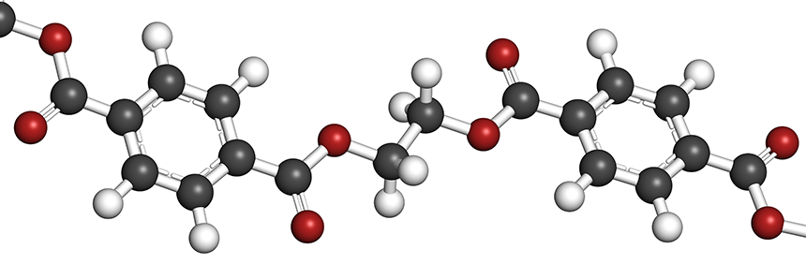
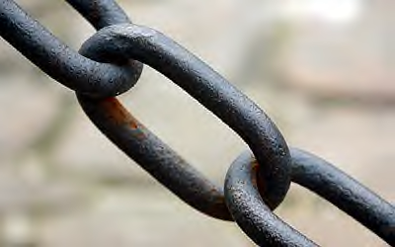
UNIT-V
POLYMER SCIENCE
Course Objective (CO-6): Glass Transiton Temperature (Tg) , Factors Influence Tg , Conducting Polymers , High polymers : Synthesis ofPolymers (Engineering)Application of polymers

Slide 2
Chapter Contents
Introduction to Polymers
Glass Transition Temperature (Tg)
Parameters affecting Tg
Chain flexibility
Intermolecular forces
Branching and Cross linking
Side chain
Molecular weight
Synthesis, Properties, Applications
TEFLON
Poly methyl methacrylate (PMMA)
Nylon-66
Urea- Formaldehyde
Conducting Polymers

Slide 3
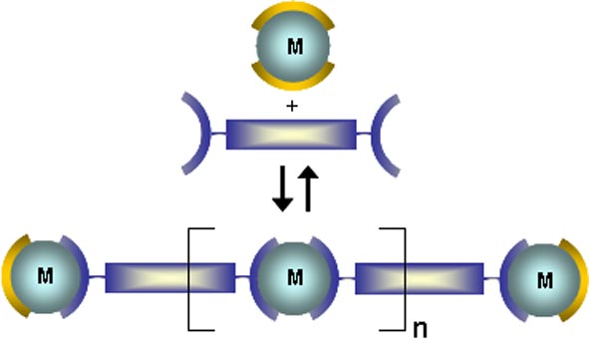
Introduction
Definition:
Polymers: Polymers are carbonous materials with a large molecular masses obtained by covalent linkages of several small repeating units called monomers
Polymerization: Polymerization is union of two or more smaller and simpler molecules of similar without elimination of any part of the molecule or molecules of different types with elimination of any part of the molecule resulting in the formation of new covalent linkages.
Monomers (M): The small molecules which combine with each other to form polymer molecules are termed as monomers.

Slide 4
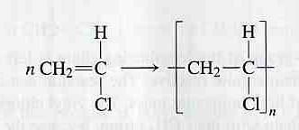
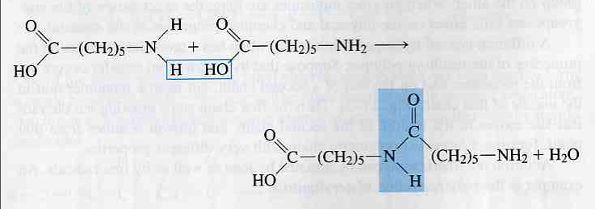
Types of polymerization
Addition polymerization: Monomers react to form a polymer without net loss of atoms.
Example: Free radical chain reaction of ethylenes
Condensation polymerization: Condensation polymers are any kind of polymers formed through a condensation reaction--where molecules join together losing small molecules as by-products such as water or methanol, as opposed to addition polymers which involve the reaction of unsaturated monomers.

Slide 5
Lecture-1
Glass transition temperature (Tg)
Factors influencing Tg
1) Flexibility
2)Intermolecular forces
3) branching and cross-linking
4) side groups
5) Mol. Wt.

Slide 6
Glass transition temperature (Tg)
Definition: The temperature at which a polymer abruptly transforms from glassy
State to the rubbery state is called glass transition temperature
Tg
Polymer in
glassy state
Polymer in
rubbery state
Glassy state | Rubbery state
Rigid, hard, solid | Visco-elastic, Soft, neither solid nor liquid
Polymer chains are randomly and closely packed | Polymer chains are randomly and loosely packed
No molecular or segmental motion | Segmental motion
Strong force of attraction between molecules and as well as segments | Strong force of attraction between molecules and weak force forces between segments
No free movement of polymer molecules/segments | No free movement of polymer molecules

Slide 7
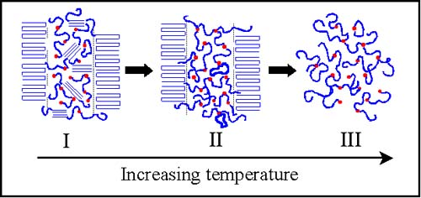
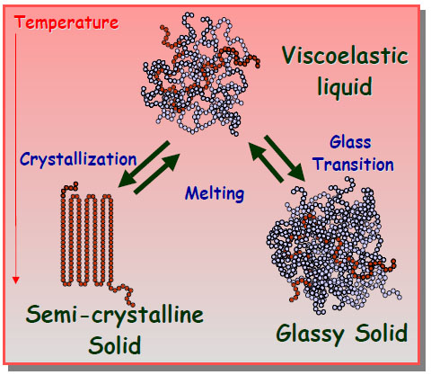
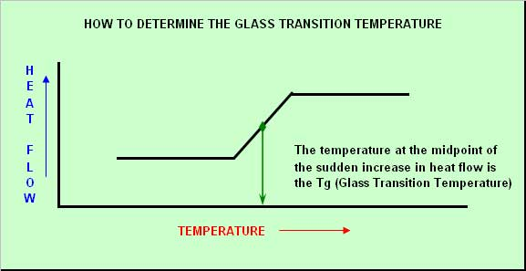

Slide 8
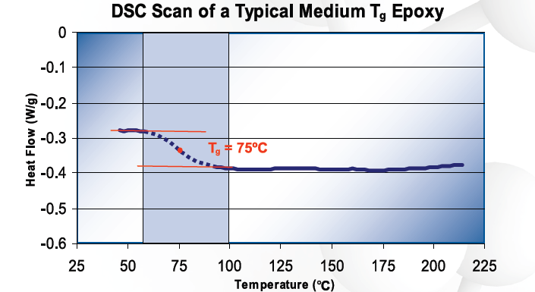
Glass transition Temp:
1) In fact, Tg is not a discrete thermodynamic transition, but a temperature range over which the mobility of the polymer chains increase significantly.
2) The ultimate Tg is determined by a number of factors: the chemical structure of the polymer, the type of hardener[ maximum curing temperature, specimen age, and heating rate] and the degree of cure.
3) Tg is usually measured using Differential Scanning Calorimetry (DSC): ASTM E1356, a Standard Test Method for Assignment of the Glass Transition Temperature

Slide 9
PVC solid | Tg=80 °C | PVC Rubbery state | Tm=310 °C | PVC liquid
Polymer | Polythene | Polybutadien | PVC | Nylon-66
Tg (°C ) | -110 | -80 | +80 | +100
Factors influencing Tg of polymer
Flexibility: (free rotation of polymer chain)
Presence of double bonds, side groups, bulky groups, cyclic rings, aromatics restricts the free rotation of polymer chain, hence flexibility decreases.
Lower the free rotation, more is the Tg.

Slide 10
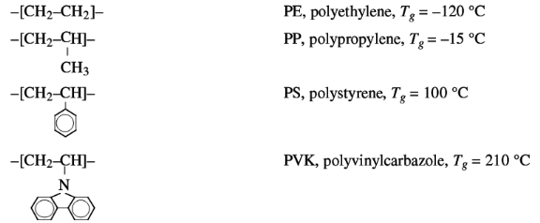
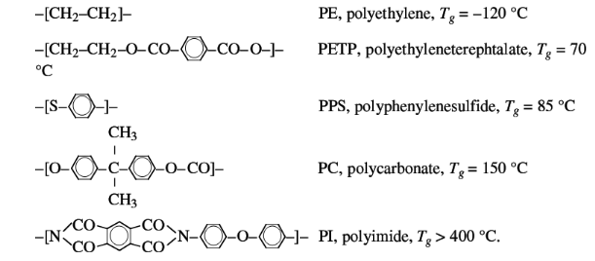
Conclusion: Flexibility decreases from PE to PVK, hence Tg also increases

Slide 11
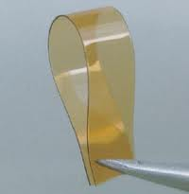
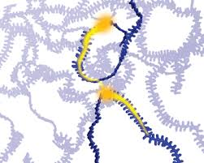
Flexibility

Slide 12
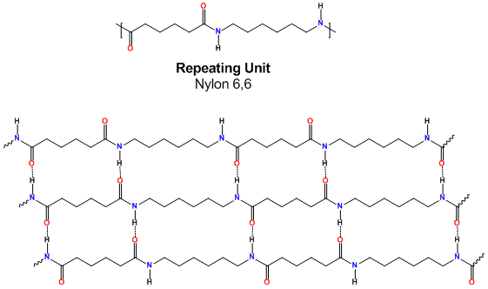
2) Intermolecular forces: H-bonding
If the intermolecular force increases , More temperature is required
to separate the polymer segments and chains, Hence, Tg also increases.
Tg of Nylon-66= +100 °C

Slide 13
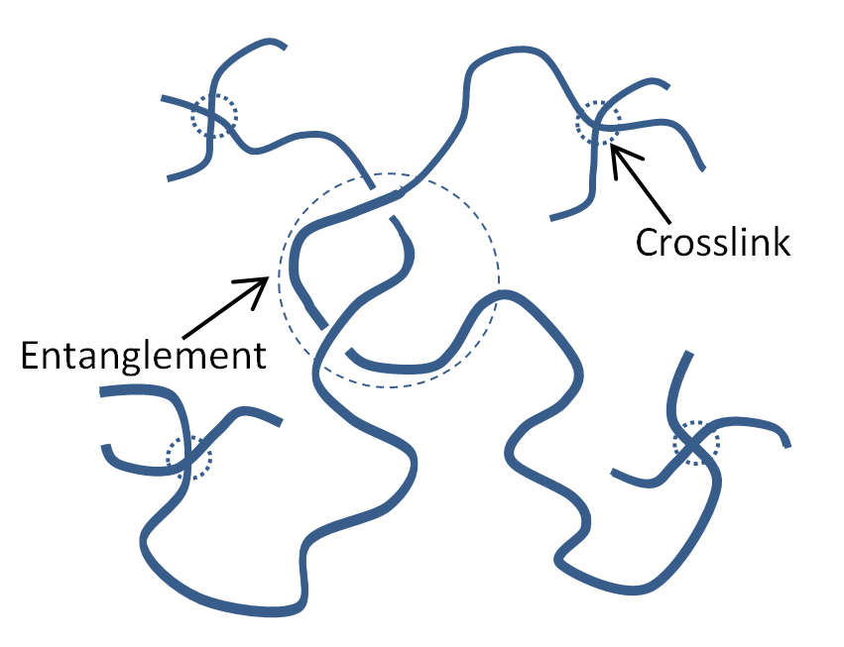
3) Branching and cross linking : A high degree of branching and cross linking in the polymer , bring the chain closer, lower the free volume thus reducing the chain mobility. Hence Tg increases.

Slide 14
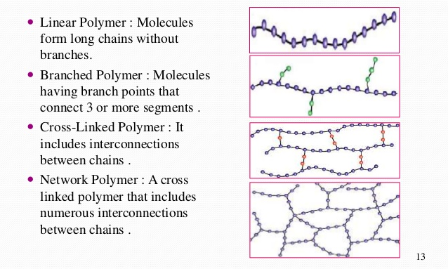

Slide 15
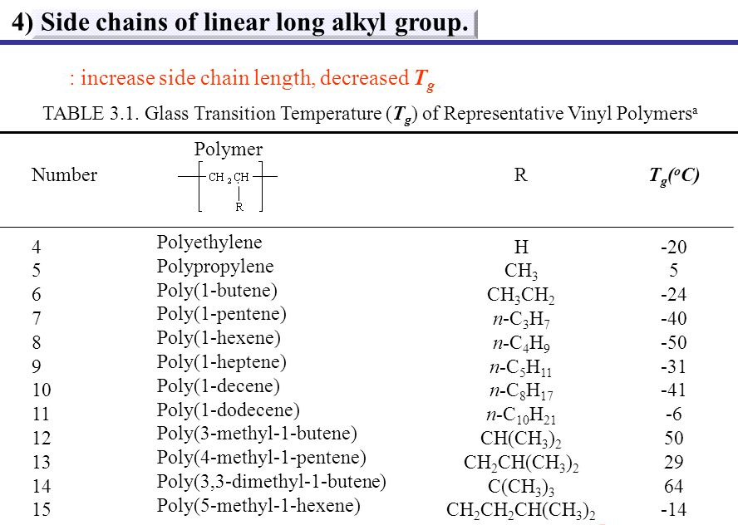

Slide 16
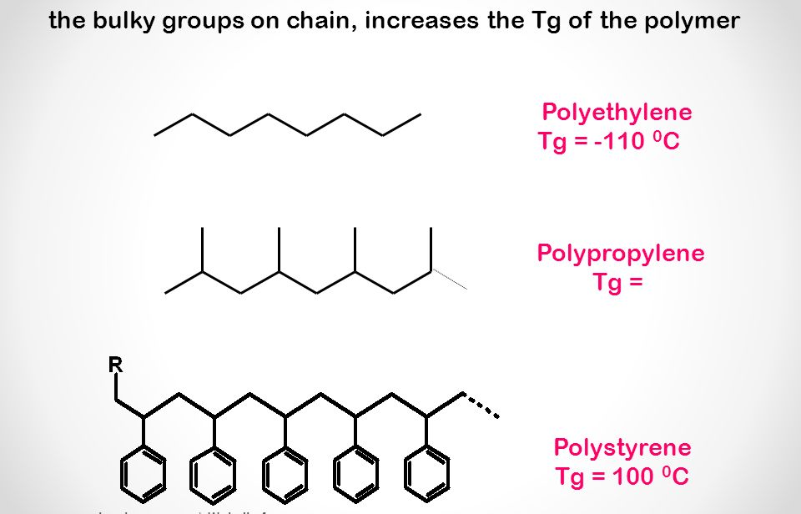

Slide 17
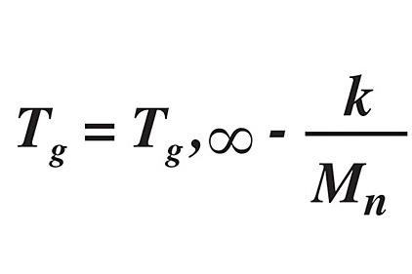
Effect of molecular weight on Tg:
1.For many polymers , Tg increases as average moeluar weight increases until a limiting value .After this any further increase in molecular weight does not increase the Tg.
Lower the molecular wt, more is the number of free ends, more flexible.
Higher the Mol wt, more is the entanglement, more heat energy is required to separate them, hence Tg increases.
It is applicable for the polymer Mol. Wt 20000 amu
2.Fox-Flory equation can be used to estimate the dependence of Tg on molecular weight.

Slide 18
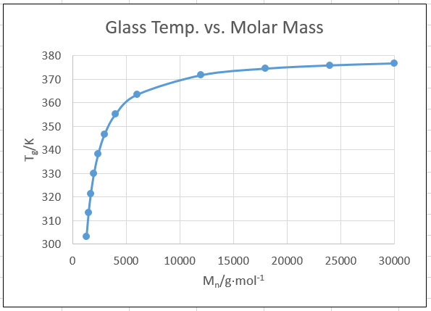
Tg,∞ = the limiting value of Tg at high molecular weight
K= constant for a given polymer (free volume inside the polymer)
Mn=number average molecular weight

Slide 19
Significance of Tg
1. Tg can be used to evaluate flexibility of a polymer and predict its response to mechanical stress
2.Many polymers change their physical properties at Tg. Hence polymer at Tg, determines the usefulness of a polymer - over a range of temperature.
3. Different fabrication works like moulding, shaping etc can be carried out with the knowledge of Tg.

Slide 22
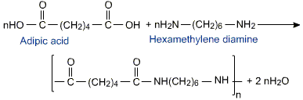
Synthesis Properties and Applications of Nylon -66
Properties:
1.It has long molecular chains resulting in more hydrogen bonds , creating chemical springs .
2. It is an amorphous solid so it has a large elastic property and is slightly soluble in boiling water .
3 .It is very stable in nature, an excellent wear and tear resistance and a high melting point
4. It is very difficult to dye but once it is dyed it has a high colour fastness and is less susceptible to fading .
5. Its chemical properties does not allow it to be affected by solvents such as water , alcohol etc

Slide 23
Advantages
1. Nylon 6,6 persues excellent abrasion resistance and a high melting point .
2.Nylon 6,6 has high tensile strength and exhibits only half of shrinkage in steam .
3. It also provides a very good resistance to photo degradation .
4.Nylon 6,6 also has good advantage over industrial products because it reduces moisture sensitivity in raw products and has a high dimensional stability and meltingpoint .
Applications:
1. Nylon 6,6 : Nylon is a light material , it is used in parachutes .
2. Nylon 6,6 is waterproof in nature so it is also used to make swimwear.
3. Nylon 6,6 having a high melting point make it more resistant to heat and friction so it is suitable to be used in in airports , offices and other places which are more liable to wear and tear.
4. Nylon 6,6 being waterproof in nature is used to make machine parts. It is also used in the following like airbags , carpets , ropes . hoses etc

Slide 24
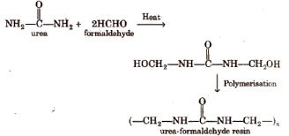
Synthesis properties and application of Urea-Formaldehyde (Resin) polymerisation
Properties
It has a high tensile strength.
It has a high capacity of low water absorption.
It has a surface hardness and heat distortion temperature
Applications
It is widely chosen as an adhesive resin due to its high reactivity, good performance, and low price.
It is used in many manufacturing processes for example, decorative laminates, textiles, paper, foundry sand molds, wrinkle resistant fabrics, cotton blends, rayon, corduroy, etc and glue for wood binding

Slide 25
CONDUCTING POLYMERS
Conducting polymers are an organic polymer which conduct electricity. Conducting polymers having the conductivity band similar to that of conductor with highly delocalised pi electron system.
Conducting polymers are generally produced by doping an oxidizing agent or reducing agent into an organic polymer with conjugated back bone consisting of pi electron system.
The conducting polymers are synthesized by doping, in which charged species are introduced in organic polymers having pi back bone. The important doping reaction are :
Oxidative doping (p-doping): In this process, pi back bone of a polymer is partially oxidised using a suitable oxidising agent like I₂ in CCl₄. This creates positively charged sites on polymer backbone, which are current carriers for conduction.
Reductive doping(n-doping): In this process, pi back bone of a polymer is partially reduced using a suitable reducing agent. This creates negatively charged sites on polymer backbone, which are current carriers for conduction.
Protonic acid doping: In this process, current carrying charged species [+vely and – vely] are created by protonation of the polymer.

Slide 26
Mechanism of Polyacetylene conductive polymer : I₂ in CCl₄ oxidative doping
Steps involved in developing conducting polymer:
1. Polyactylene is a conjugated polymer consisting in presence of alternating double bond and single bond , also has a linear structure.
2. Polymer becomes conducting upon doping of I₂ in CCl₄ and the electron from the pi- back bone is removed creating a vacancy or hole, thus the molecule becomes positively charged.
3. As the result of it , the other lone electron of the double bond can move easily along the Polymer chains , is called delocalised electron. They have extended p-orbital system.
4. Concentration of dopant causes certain electrons to become unpaired and the formation of polarons and bipolarons

Slide 27
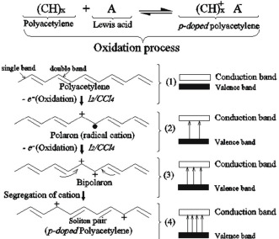
5. The positive charge on the other hand is fixed by the electron-static attraction to the iodide, and allow electrons to move throughout the chain sothat it acts as a conductor.

